Slide 1
International Travel and Call EDA

Slide 2

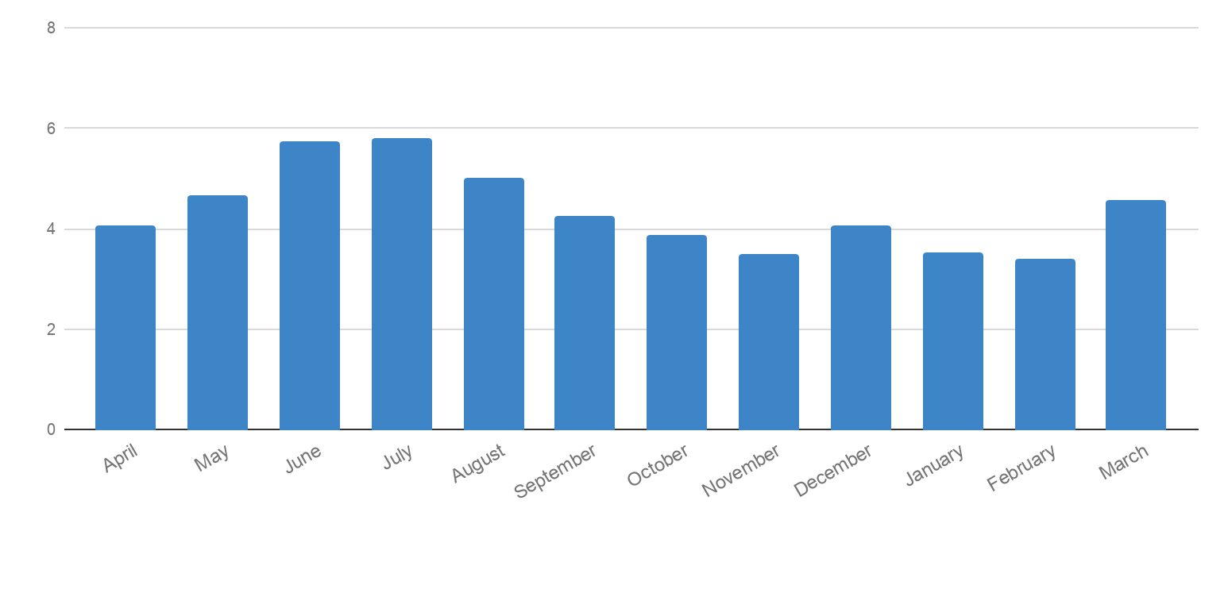
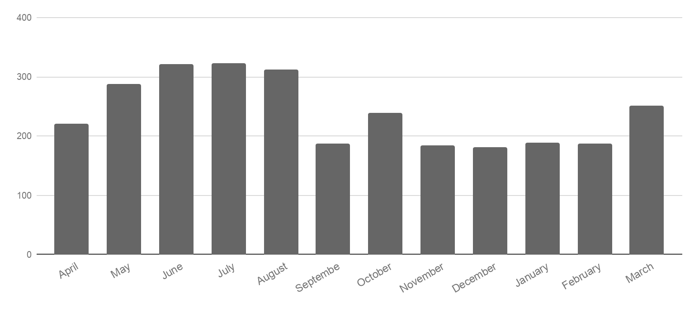
International Trips
2018
2019
Travelers (Millions)
4.08 M
4.66 M
5.74 M
5.8 M
5.02 M
4.26 M
3.88 M
3.5 M
4.06 M
3.53 M
3.39 M
4.57 M
2018
2019
Callers (Thousands)
220,604
287,359
321,428
322,895
312,806
186,810
238,694
184,976
181,028
188,960
187,011
252,024
Current State- Observations
Avg 9.6% of calls are international calls April’ 18 - March’ 19 total yearly international calls: ~ 2.88 M April’ 19 - March ‘ 19 Total yearly international trips: ~ 52.5 M* *Ref Welcome SMS
Notes:
Split the two graphs and make the woman lighter. Make bar charts.

Slide 3

International Traveler Journey Steps/Pain Points
1
customer thinks about traveling
2
customer searches for available VZ plans
3
before travel
calls for plan inquiry / information
> 300 calls
manual listening
4
calls for confirmation / activation
5
customer receives welcome message
6
during travel
customer tries to fiddle with phone settings
7
customer calls for network coverage / settings
8
customer call for extending their plans
9
customer call for plan deactivation
customer receives the bill + bill shock
10
customer call for bill explanation / bill credit
11
after travel
12
customer pays the bill
Notes:
> 300 calls
What verint tells is 90% travel pass and 5% international travel plan and dial device settings. doesn’t cover reasons what about travel pass

Slide 4
Customer Journey Sequence Level Deep Dive by Customer Type
Customer Type | Exit Point Available | Importance | # of Customers | Min Length of Sequence | Max Length of Sequence | Avg. Length of Sequence | 1st Quartile of Sequence Length | Median of Sequence Length | 3rd Quartile of Sequence Length | Min of Distinct Events | Max of Distinct Events | Avg. of Distinct Events | 1st Quartile of Distinct Events | Median of Distinct Events | 3rd Quartile of Distinct Event
Travelers with Travel Intent | Yes | High | 2,401 K | 3 | 100 | 22 | 12 | 18 | 27 | 3 | 32 | 9 | 7 | 8 | 10
Non-Travelers with Travel Intent | Yes | High | 5,268 K | 3 | 100 | 10 | 5 | 8 | 12 | 1 | 26 | 5 | 3 | 4 | 6
Travelers w/o Travel Intent | Yes | High | 8,360 K | 3 | 100 | 8 | 4 | 6 | 10 | 2 | 27 | 4 | 3 | 4 | 5
Non-Travelers w/o Travel Intent | Yes | Low | 72,263 K | 3 | 100 | 5 | 3 | 3 | 6 | 1 | 16 | 2 | 2 | 2 | 3
Travelers with Travel Intent | No | Low | 0.4 K | 3 | 77 | 14 | 6 | 11 | 20 | 2 | 21 | 5 | 3 | 5 | 7
Travelers w/o Travel Intent | No | Low | 0.9 K | 3 | 92 | 8 | 3 | 5 | 10 | 1 | 17 | 3 | 1 | 3 | 4
Sequence Logic:
Travelers within Oct’18 – Jun’19
Exit Point – Bill Due Date + 2 weeks
Travelers having TP Purchase as intent: Go back till Oct’18 and look for TP Intent other than TP Purchase

Slide 5
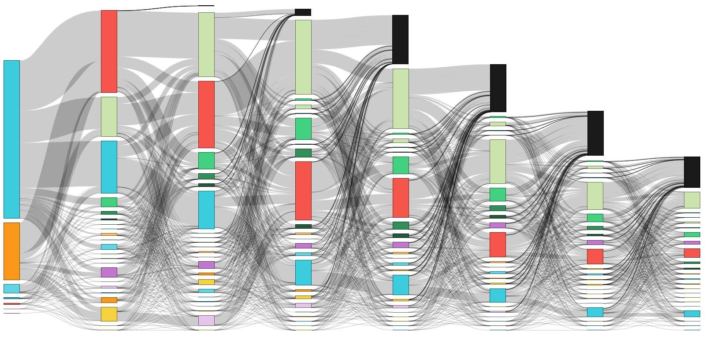
Sankey Chart for Travelers with Intent*
15K
Intl Travel
Bill
Call
Scat/Mobile
SMS
TP Purchase
Others
Exit Point
# of Lines in interaction
157K
120K
202K
183K
147K
117K
108K
97K
164K
52K
389K
40K
108K
128K
42K
75K
143K
95K
32K
40K
22K
67K
90K
19K
60K
36K
140K
6K
62K
22K
12K
48K
12K
34K
Interaction Sequence
First 8 interactions in sequence
**High Bill: 40%+ growth in bill
* Others = Categories apart from the legends
N-size: Customers whose sequence length ≤ 15 (~1.3 M)
Travelers within Oct’18 – Jun’19
Exit Point – Bill Due Date + 2 weeks

Slide 6
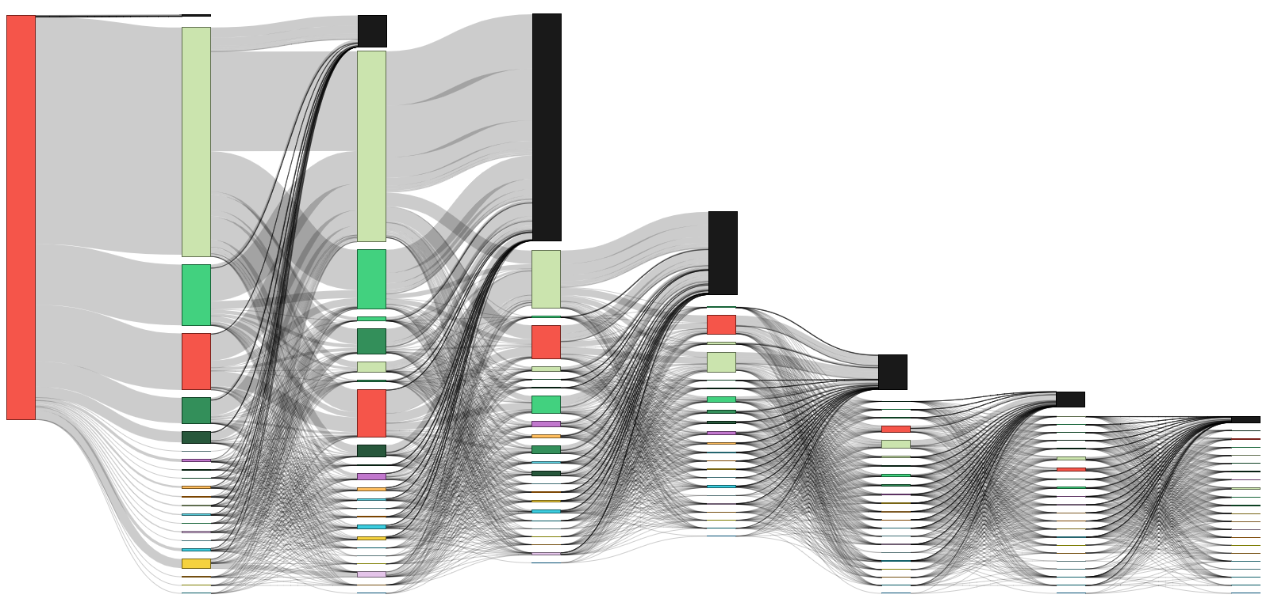
Sankey Chart for Travelers without Intent*
584 K
Intl Travel
Bill
Call
Scat/Mobile
SMS
TP Purchase
Others
Exit Point
# of Lines in interaction
4.1 M
4.2 M
3.5 M
1.5 M
1.1 M
1.0 M
1.0 M
7.4 M
456 K
340 K
618 K
1.1 M
370 K
636 K
474 K
881 K
323 K
175K
Interaction Sequence
First 8 interactions in sequence
**High Bill: 40%+ growth in bill
* Others = Categories apart from the legends
N-size: Customers whose sequence length ≤ 15 (~4.8 M)
Travelers within Oct’18 – Jun’19
Exit Point – Bill Due Date + 2 weeks

Slide 7
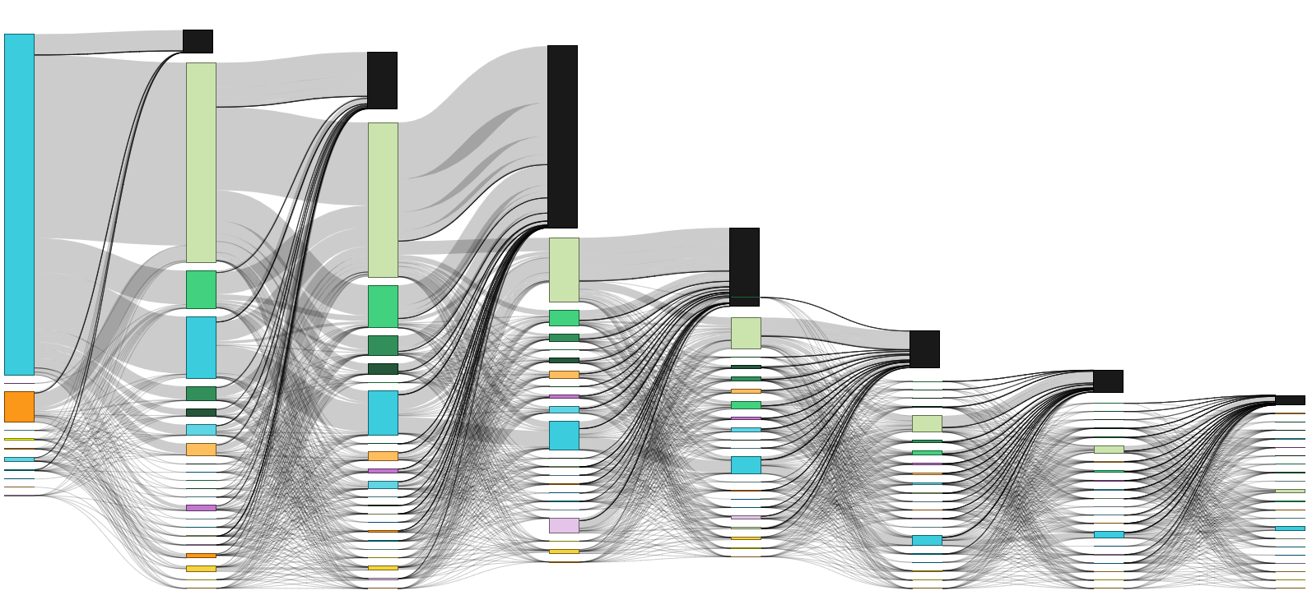
Sankey Chart for Non-Travelers with Intent*
Intl Travel
Bill
Call
Scat/Mobile
SMS
TP Purchase
Others
Exit Point
228K
578K
# of Lines in interaction
2 M
1.8 M
3.4 M
1.5 M
652 K
797 K
383K
431K
623K
194K
320 K
372 K
311 K
145K
453K
123K
290K
Interaction Sequence
First 8 interactions in sequence
**High Bill: 40%+ growth in bill
* Others = Categories apart from the legends
N-size: Customers whose sequence length ≤ 15 & >1 (~5.3 M)
Time Frame: Dec ‘18 – Apr ‘19

Slide 8
December Month Traveler’s Statistics

Slide 9
Total consumer customers : 95 million
Total December monthly calls : 10 million
Total internal December calls : 2.5 million
6.1% of the total call volume- international
$ opportunity numbers are annual
Models
Call Intent Prediction (Agent Assist)
Call/No call (Proactive self serve)
Plan purchase propensity
IVR Rules
Assumptions:
Calls numbers made between Dec 1 -31 : travelled up to 30 days before or 45 days after the call
-20$ per hour cost of call, Avg call duration : 30 mins
-50% call time reduction for agent assist models
-Avg int. travel duration : 7 days = $35 sales
Before trv 25K
After trv 11K
No trv 18.5 K
35K Break &Call
41K mobile
Int Pg 5K then call
73K purchased plan before travel
Total Calls
154,439
55.5K visit website before calling
14K Online
5K purchased during travelf
Brk & Call 11K
18K Called after travel
78K Plan Purchased
7.5 K Visit Int Pg
Int Pg then Call 2.5 K
Travelled
109K
Not Travelled
45K
1.6K called & purchased plan before called after
33K Plan not Purchased
4.5K 0-10 days before travel
PP After call 300
3.6 K +25% Bill
Called After
31K
Int. Pg. 1.6K
Desktop 7K
25K visited Website’/
Called Before
78K
11K visited mob/web
PP before call 1K
4.6 K +10% Bill
2.8K (out of4.5K) calls have Potential to migrate to Self Serve
PP before call 1K
Plan Purchased before Call 47K
Plan Not Purch 12.3K
Plan Purchased 18.3 K
Int. Pg. 1.6K
Mobile 18K
Decrease calls by selling before travel pass
Potential to move customers towards self serve
$5.7M Service
Assumption : 12 K with plan didn’t visit mobile
PP After call 300
Potential to move customers towards self serve
Plan Not Purchased 20K
$$24M Service
Potential to increase travel pass purchase
$4.5M Sales
$2.4M Service
Plan Purchased after Call 11K
IVR
Plan purchase propensity model
$2.25M
Service
Predictive model to help call center agent to sell the plan to the right customer
5K Potential call reduction
based on primary results

Slide 10
Total consumer customers : 95 million
Total December monthly calls : 10 million
Total international December calls : 2.5 million
6.1% of the total call volume
Before trv 25K
After trv 11K
No trv 18.5 K
35K Break &Call
41K mobile
Int Pg 5K then call
73K purchased plan before travel
Total Calls
154,439
55.5K visit website before calling
14K Online
5K purchased during travelf
Brk & Call 11K
18K Called after travel
78K Plan Purchased
7.5 K Visit Int Pg
Int Pg then Call 2.5 K
Travelled
109K
Not Travelled
45K
1.6K called & purchased plan before called after
33K Plan not Purchased
4.5K 0-10 days before travel
PP After call 300
3.6 K +25% Bill
Called After
31K
Int. Pg. 1.6K
Desktop 7K
25K visited Website’/
Called Before
78K
11K visited mob/web
PP before call 1K
4.6 K +10% Bill
2.8K (out of4.5K) calls have Potential to migrate to Self Serve
PP before call 1K
Plan Purchased before Call 47K
Plan Not Purch 12.3K
Plan Purchased 18.3 K
Int. Pg. 1.6K
Mobile 18K
Decrease calls by selling before travel pass
Potential to move customers towards self serve
PP After call 300
Potential to move customers towards self serve
Plan Not Purchased 20K
Plan Purchased after Call 11K
Potential to increase travel pass purchase
Criterion:
Calls numbers made between Dec 1 -31 : travelled up to 30 days before or 45 days after the call
5K Potential call reduction
based on primary results
Predictive model to help call center agent to sell the plan to the right customer

Slide 11
Total consumer customers : 95 million
Total December monthly calls : 10 million
Total international December calls : 2.5 million
6.1% of the total call volume
Before trv 25K
After trv 11K
No trv 18.5 K
35K Break &Call
41K mobile
Int Pg 5K then call
73K purchased plan before travel
Total Calls
154,439
55.5K visit website before calling
14K Online
5K purchased during travelf
Brk & Call 11K
18K Called after travel
78K Plan Purchased
7.5 K Visit Int Pg
Int Pg then Call 2.5 K
Travelled
109K
Not Travelled
45K
1.6K called & purchased plan before called after
33K Plan not Purchased
4.5K 0-10 days before travel
PP After call 300
3.6 K +25% Bill
Called After
31K
Int. Pg. 1.6K
Desktop 7K
25K visited Website’/
Called Before
78K
11K visited mob/web
PP before call 1K
4.6 K +10% Bill
2.8K (out of4.5K) calls have Potential to migrate to Self Serve
PP before call 1K
Plan Purchased before Call 47K
Plan Not Purch 12.3K
Plan Purchased 18.3 K
Int. Pg. 1.6K
Mobile 18K
Decrease calls by selling before travel pass
Potential to move customers towards self serve
PP After call 300
Potential to move customers towards self serve
Plan Not Purchased 20K
Plan Purchased after Call 11K
Potential to increase travel pass purchase
Criterion:
Calls numbers made between Dec 1 -31 : travelled up to 30 days before or 45 days after the call
5K Potential call reduction
based on primary results
Predictive model to help call center agent to sell the plan to the right customer

Slide 12
Total consumer customers : 95 million
Total December monthly calls : 10 million
Total international December calls : 2.5 million
6.1% of the total call volume
Models
Call Intent Prediction (Agent Assist)
Call/No call (Proactive self serve)
Plan purchase propensity
IVR Rules
$ Opportunities - annual Numbers - Monthly, Internal
Before trv 25K
After trv 11K
No trv 18.5 K
35K Break &Call
41K mobile
Int Pg 5K then call
73K purchased plan before travel
Total Calls
154,439
55.5K visit website before calling
14K Online
5K purchased during travelf
Brk & Call 11K
18K Called after travel
78K Plan Purchased
7.5 K Visit Int Pg
Int Pg then Call 2.5 K
Travelled
109K
Not Travelled
45K
1.6K called & purchased plan before called after
33K Plan not Purchased
4.5K 0-10 days before travel
PP After call 300
3.6 K +25% Bill
Called After
31K
Int. Pg. 1.6K
Desktop 7K
25K visited Website’/
Called Before
78K
11K visited mob/web
PP before call 1K
4.6 K +10% Bill
2.8K (out of4.5K) calls have Potential to migrate to Self Serve
PP before call 1K
Plan Purchased before Call 47K
Plan Not Purch 12.3K
Plan Purchased 18.3 K
Int. Pg. 1.6K
Mobile 18K
Decrease calls by selling before travel pass
Potential to move customers towards self serve
PP After call 300
Potential to move customers towards self serve
Plan Not Purchased 20K
Criterion:
Calls numbers made between Dec 1 -31 : travelled up to 30 days before or 45 days after the call
-20$ per hour cost of call
-50% call time reduction for agent assist models
$$24M Annual
Plan Purchased after Call 11K
Potential to increase travel pass purchase
IVR
Plan purchase propensity model
$2.25M
Predictive model to help call center agent to sell the plan to the right customer
5K Potential call reduction
based on primary results

Slide 13
Total consumer customers : 95 million
Total December monthly calls : 10 million
Total international December calls : 2.5 million
6.1% of the total call volume
Before trv 25K
After trv 11K
No trv 18.5 K
35K Break &Call
41K mobile
Int Pg 5K then call
73K purchased plan before travel
Total Calls
154,439
55.5K visit website before calling
14K Online
5K purchased during travelf
Brk & Call 11K
18K Called after travel
78K Plan Purchased
7.5 K Visit Int Pg
Int Pg then Call 2.5 K
Travelled
109K
Not Travelled
45K
1.6K called & purchased plan before called after
33K Plan not Purchased
4.5K 0-10 days before travel
PP After call 300
3.6 K +25% Bill
Called After
31K
Int. Pg. 1.6K
Desktop 7K
25K visited Website’/
Called Before
78K
11K visited mob/web
PP before call 1K
4.6 K +10% Bill
2.8K (out of4.5K) calls have Potential to migrate to Self Serve
PP before call 1K
Plan Purchased before Call 47K
Plan Not Purch 12.3K
Plan Purchased 18.3 K
Int. Pg. 1.6K
Mobile 18K
Decrease calls by selling before travel pass
Potential to move customers towards self serve
PP After call 300
Potential to move customers towards self serve
Plan Not Purchased 20K
Plan Purchased after Call 11K
Potential to increase travel pass purchase
Criterion:
Calls numbers made between Dec 1 -31 : travelled up to 30 days before or 45 days after the call
5K Potential call reduction
based on primary results
Predictive model to help call center agent to sell the plan to the right customer

Slide 14
Sep 18-Feb 19 Travelers by country

Slide 15
17-18 Calls monthly

Slide 16

International Travel: Call Category and Subcategory - Annually
International Calls
(2.88 M)
Plan & TravelPass®️
(48%, 1.38 M)
Billing
(16%, 460k)
Cruise
(9%, 259k)
Phone Settings
(9%, 259k)
Family
(8.6 %, 247.6k)
Coverage
(8.6 %, 247.6k)
TravelPass®️ Enquiry
(34%, 0.98 M)
Bill Details
(14%, 403k)
Cruise Bill
(1.7%, 49k)
Device Settings
(6%, 173k)
Plan Data &WIFI
(10.07%, 290k)
Bill Credit
(1.6%, 46k)
Cruise Plan
(6%, 173k)
Data & WIFI
(2.6%, 74.8k)
Legend
Add Plan/TP
(2%, 57.6k)
Device Payment
(0.27%, 7k)
Setting
(1.2%, 34.5k)
SIM Card
(0.26%, 7.5k)
Plan Data and Wifi | Customer interested in Data Services when travelled internationally.
Bill Credit | Customers that has problems with their Account and Credit is offered.
Data and Wifi (Settings) | Instructions regarding Wifi and setting up Hotspot.
SIM Card | Customers having issues with change of SIM and other SIM related problems.
Family | Customers calling on behalf of their family.
Activate Plan/TP
(1.13%, 37.4k)
SIM Card
(0.03%, 864)
Discount
(0.74%, 21.3 k)
Change Plan
(0.5%, 14.4k)
Remove TP
(0.24%, 6k)
Verizon confidential and proprietary. Unauthorized disclosure, reproduction or other use prohibited.
Verizon confidential and proprietary. Unauthorized disclosure, reproduction or other use prohibited.
Notes:
2.88 is not annual call volume - 2.66 is ! 2.88 counts April twice. we will have to change these again -_-

Slide 17

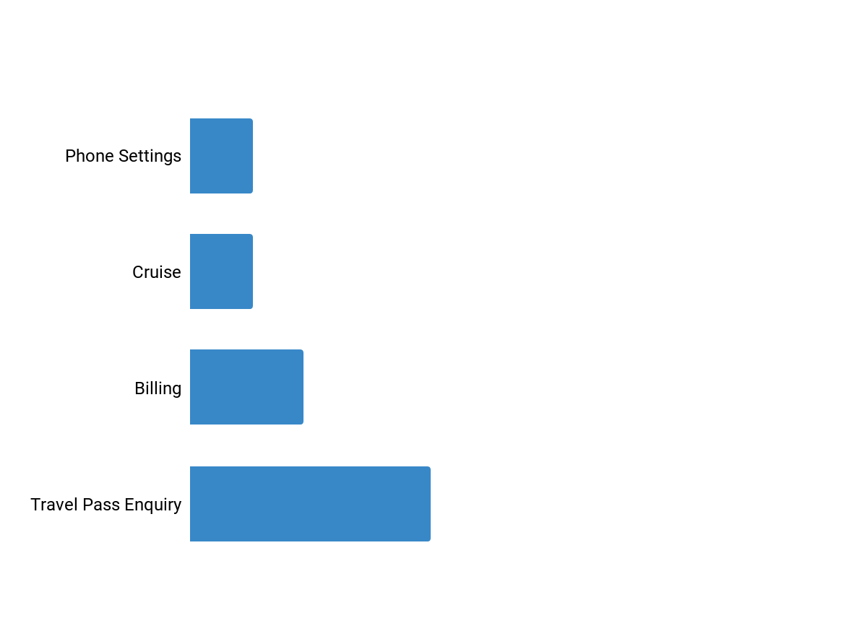
Top Call Reasons And Agent Actions
Classification | Amount of annual calls | Average handling time | Agent Actions
9% | 259 K | 15 mins | Troubleshooting the settings. Providing information about accessing WIFI , cellular data and Roaming.
9% | 259 K | 15 mins | Provide information about cruise plan,settings and the billing information describing how the charges will incur when the bill is generated.
16% | 460 K | 30 mins | Provide the details of the bill. Provide bill credit if there is a bill shock.
34% | 980 K | 10 mins | Provide information about general customer query regarding travel plan,,cellular data usage and the billing cycle information.

Slide 18

Action Required Calls
No Action Required Calls
Calls | No. of Customers Annually
Add Plan | 57.6K
Billing/Bill Credit | 46K
Cruise Bill Credit | 5K
Remove Plan | 6K
Calls | No. of Customers Annually
Plan & TravelPass®️ Enquiry | 980K
Billing/Bill Details | 403K
Settings/Cruise Settings | 259K/34.5K
Cruise Plans | 173K

Slide 19
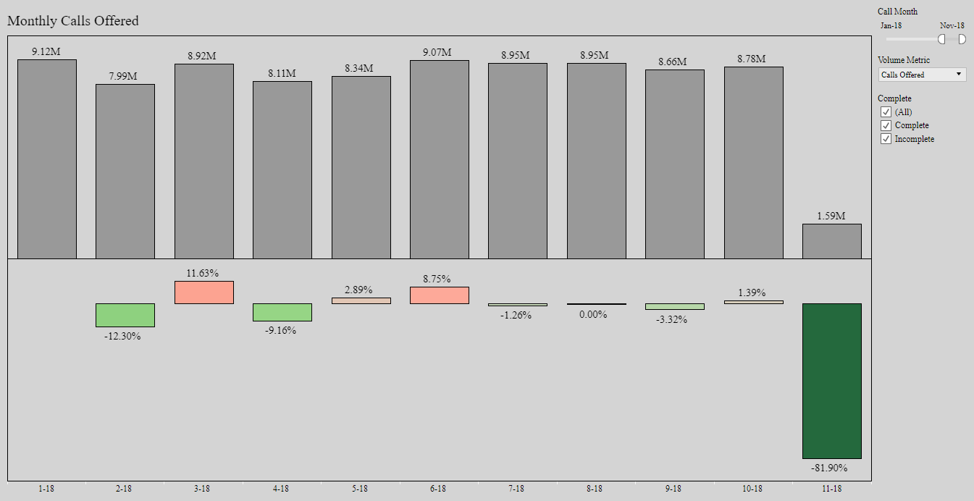
Overall Call Volume Trend- Monthly

Slide 20
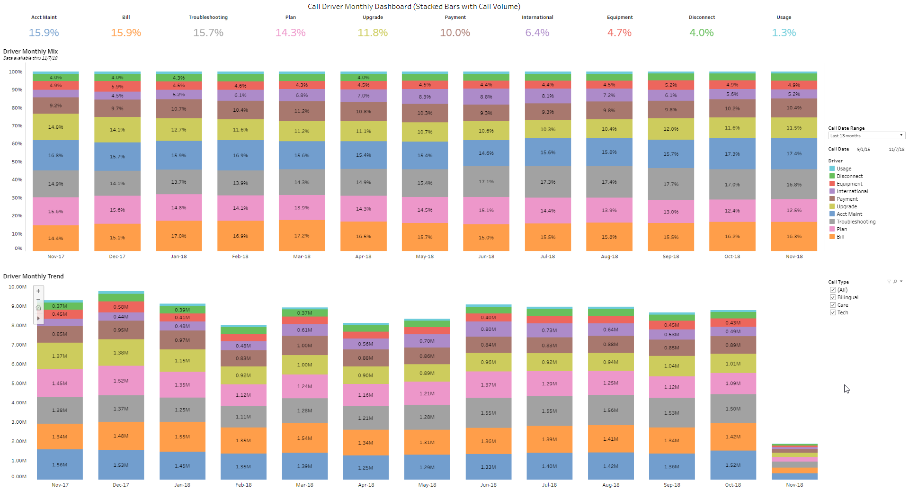
Call Driver Volume- Monthly

Slide 21
Travelers Summary
Dec’18 - May’19
Travellers
Dec | ~2.1M
Jan | ~1.7M
Feb | ~1.7M
Mar | ~2.3M
Apr | ~2.1M
May | ~2.5M
Travelled
~ 12.5 Million
Calls Received
~ 800k
Callers
Dec | ~130k
Jan | ~ 120k
Feb | ~ 123k
Mar | ~163k
Apr | ~157k
May | ~180k
Before Travel
~580 K
After Travel ~250 K
Top 10 Countries Visited
Mexico ~ 28%
Canada ~ 25%
Cruise ~ 9%
Britain ~ 3.5%
DOM ~ 2.6%
Bahamas ~ 2%
Jamaica ~ 2%
Callers
Dec | ~90k
Jan | ~75k
Feb | ~82k
Mar | ~111k
Apr | ~105k
May | ~137k
Callers
Dec | ~42k
Jan | ~36k
Feb | ~41k
Mar | ~53k
Apr | ~53k
May | ~42k

Slide 22
.com Visitors
Average:Nov’18 - Apr’19
Travellers
Nov | ~23.9 M
Dec | ~22.7 M
Jan | ~22.4 M
Feb | ~20.1 M
Mar | ~21.9 M
Apr | ~20.4 M
.com visitors/month
~ 21.9 Million
International page visitors
~ 876 k
Trip planner visitors
~ 327 k
Plan purchased on .com
~ 47.6 k
Observations
Monthly 900K visitor to Internations 23% of International page visitors purchasing travel plan but not all on .com. Only 5 % purchasing on .com and rest choosing other channels majority contact center
Plan purchased .com | 47.6 k (5%)
Plan purchased non .com | 153.2 k (17%)
Plan not purchased | 675.2 k(77%)

Slide 23
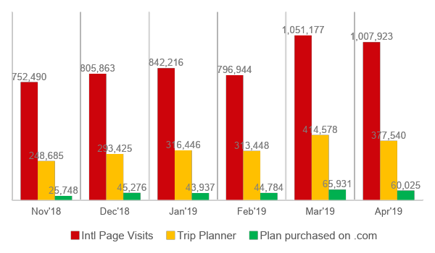
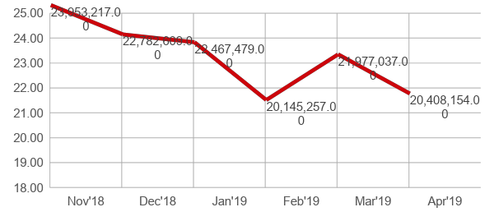
.COM Visitors Statistics
Nov’18 - Apr’19
.COM Visitors
Over six month period on average 23 mil/ month users visiting Verizon online
4 % of online page visitors (23 mil) visiting International page
5 % International page visitors (Avg 876 K ) subscribing international plan

Slide 24
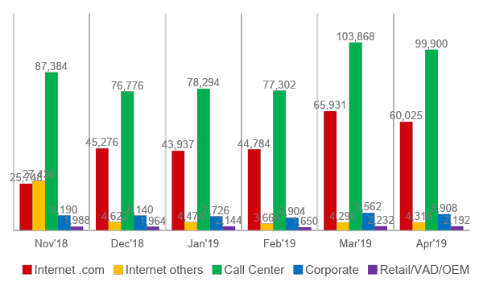
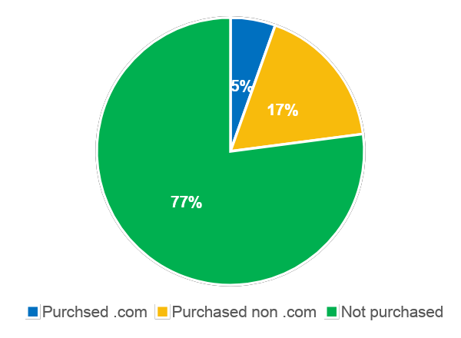
.COM Visitors purchase Statistics
Over six month period on average 5% international page visitors purchasing product online, 18 % choosing other channels and 77 % not purchasing the plan
Notes:
57 % International travelers who visited International page called Call center to purchase International plan

Slide 25
Callers Data Set
data
Jan | 176k
Feb | 175k
Mar | 236k
Apr | 224k
May | 274k
Total Calls ~ 1 Mill | Repeat Calls ~ 97 k
data
Jan | 15 k
Feb | 14 k
Mar | 21 k
Apr | 20 k
May | 25 k
Traveled ~ 700 k | Not Traveled ~ 301 k
Before Travel ~635 k | After Travel ~180 k
data
Jan | 115 k
Feb | 100 k
Mar | 136 k
Apr | 125 k
May | 153 k
data
Jan | 15 k
Feb | 31 k
Mar | 42 k
Apr | 43 k
May | 49 k
Customers Traveled
~ 700 k

Slide 26
Appendix A

Slide 27
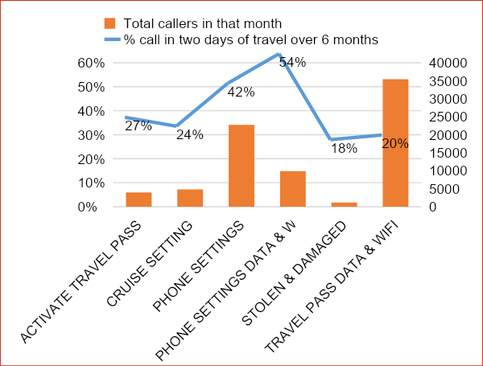
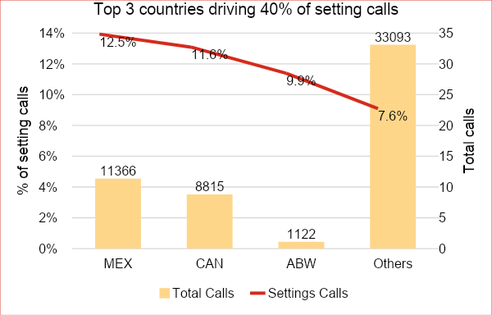
NLP Insights: Phone Settings calls – 52K
Evaluated based on same month traveled and called.
Average of 12% of calls coming from Mex, Can and AWB are travelers calling for phone settings – highest in any category
50% of setting calls are coming within 48 hours of travel.
December’18-May’19

Slide 28



Background
Algorithm built was carried on international call transcript data from Oct’18 to Dec’18.
Removed stop words.
Removed the names/country names which are not relevant.
Lemmatization of words using parts of speech.
Relevant Keyword extraction using Mutual Information Theory
Text Classification with Bag of Words.
Position assignation to classify categories.
The validation / analysis is done on international call transcript data on Dec’18
Data Description
Data Processing
Approach
Data Description

Slide 29
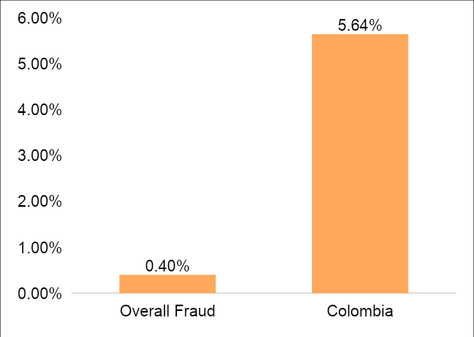
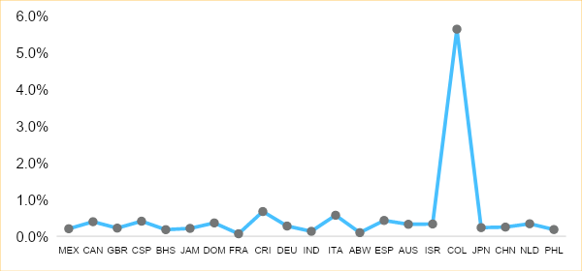
Fraud Calls Analysis
Total number of calls for Colombia for the month of December’18 is 1330.
The Fraud distribution for the country of Colombia is significantly higher than the overall fraud calls received. Colombia has the highest percentage of fraud calls among the countries which are significant contributors in terms of total calls received by Verizon.

Slide 30
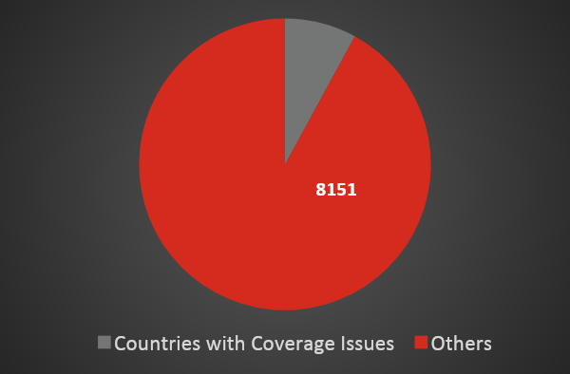
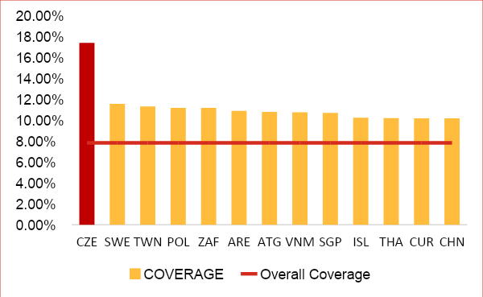
Coverage Analysis
704
3511
Overall
Coverage calls
7.83%
5344
Total calls received: 113k
Coverage Calls: 8855 (7.83%)
The countries are selected with a threshold of coverage>=10% and total number of calls >=200 to avoid selecting countries getting less significant amount of calls for Verizon.
The above countries accounts for 8% of calls which are made for coverage enquiries. Czech Republic has the highest number of calls which is 10% higher than the overall calls received for coverage enquiry. The issue is particularly observed in the South East Asian countries.

Slide 31
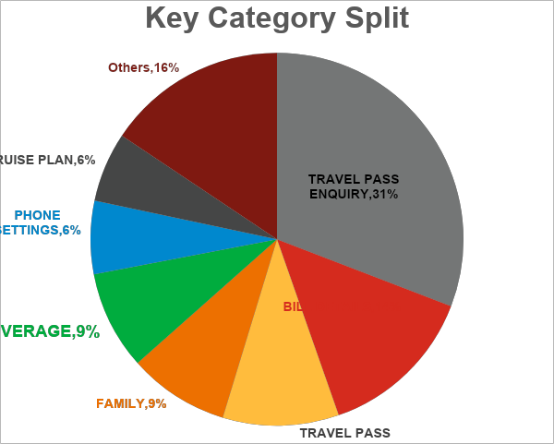
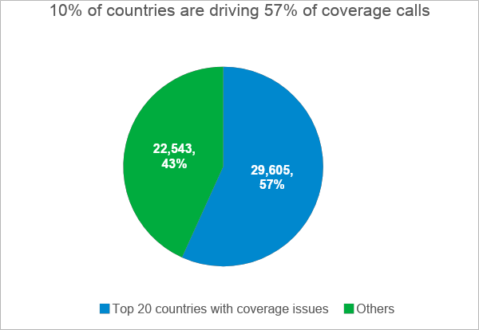
Coverage Analysis
704
3511
5344
The countries are selected with a threshold of coverage>=9% calls for the country and total number of calls >=3500 to avoid selecting countries getting less significant amount of calls
8% (52K) of callers are calling for checking the coverage present in the visitor country.
December’18-May’19

Slide 32

International travel page analysis- 19K calls could have been reduced using right communication
Total calls Before Travel
550K (100%)
Visited Online
Visited Mobile
99K (18%)
151k (28%)
International Page Visited = Yes
International Page Visited = No
Not Purchased Plan
International Page Visited = Yes
International Page Visited = No
128K (23%)
35K (35%)
64K (65%)
27K (18%)
123K (81%)
Purchased Plan Before call
Not Purchased Plan
Purchased Plan after call
Opportunity 2: 7.5K calls are sales calls – potential to reduce by sending the right message by creating a predictive model
19k (19%)
8k(8%)
7.5k (7.5%)
Opportunity 1: 19K calls have Potential to migrate to Self Serve
December’18,Feb’19-May’19
Notes:
Opportunity 1: 19K calls have Potential to migrate to Self Serve
Opportunity 2: 7.5K calls are sales calls – potential to reduce by sending the right message by creating a predictive model

Slide 33
$2.4M potential Opportunity to sell travel pass by predicting propensity to buy
Plan Purchased without Call
(56%,6M)
Travelled
(11M)
(0.6M * $5 per travel pass * 1/3rd up take) =
0.6M*5*1/3 = $1M for 5 months ~ $2.4M per annum
Opportunity to sell travel pass to customers using predictive model for incremental revenue of $2.4M
Visited Online
(14%,0.6M)
International Page Visited
(24%, 0.1M)
Plan Purchased before call
(5%, 0.5M)
Plan Purchased after call
(1.15%, 0.1M)
Called and not purchased 2%,183k
Plan not Purchased
(38%,4M)
December’18,Feb’19-May’19
Notes:
Visits to website
Plan not Purchased
(38%,4M)
Opportunity to sell travel pass to customers using predictive model

Slide 34






Summary
Algorithm was built on international call transcript data from Oct’18 to Dec’18.
Algorithm ran on 10 months of call transcripts from Sep’18 to May’19
Accuracy achieved by the algorithm – 70%
Algorithm can be extended across multiple domains (billing, accounts, plan & data).
Key Insights based on Dec’18 to May’19
Device Setting Calls | Device Setting Canada Vs Mexico | Calls after visiting the website | Calls for Network Coverage | Call Enquiry made behalf on family
28K 40% within 48 hrs of travel | 3.6K 60% within 48 hrs 5.3K 40% within 48 hrs of travel | 40% of them are on Travel Pass (36K) within 48 hrs of website visit. . | 52K (8%) network coverage in the visiting country | 59K (9%) for travel pass
Legend:
*customer travels & calls in the same month
*website visit within 7 days prior to travel
Verizon confidential and proprietary. Unauthorized disclosure, reproduction or other use prohibited.
Notes:
Key Insights based on 5 months of data
40% of 28K device setting calls who travelled and called in the same month per annum are within 48 hours of travel between December’ 18 and May’19.
For Canada vs Mexico for the above insight, 60 % of the 3.6K are calls from Canada and 40% of the 5.3K calls are from Mexico.
40% of the customer enquiries on Cruise(5K) and Travel Pass(36K) occur in 48 hours of website visit. Given that customer travels and calls in the same month and website visit occurs within 7 days prior to travel.
8% (52K) of callers are calling for Network coverage in the visiting country
9% (59K) of callers are calling on behalf of their family for Travel Pass Enquiry

Slide 36
Appendix B
Insights

Slide 37
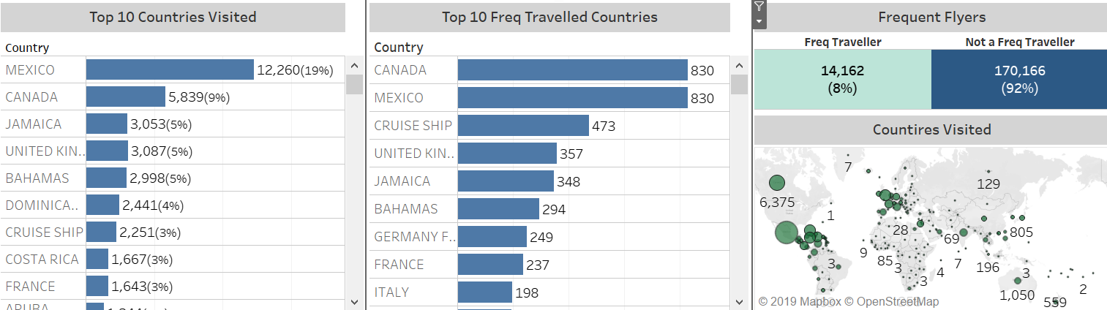
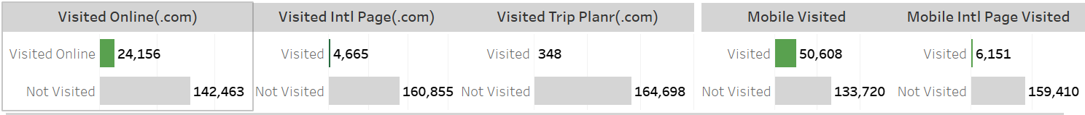
International Call Dec Monthly Insights Example (Internal)

Slide 38



Summary
Algorithm was built on international call transcript data from Oct’18 to Dec’18.
Algorithm ran on 10 months of call transcripts – From Sep’18 to May’19
Accuracy achieved by the algorithm – 70%
Algorithm can be extended across multiple domains (Billing, Accounts, Plan & Data)
Key Insights based on 5 months of data
50% (30k)
of phone setting calls are coming within
48 hours of travel
8% (52k)
of callers are calling for network coverage in the visiting country
12%
Majority of phone settings calls are from Canada and Mexico
9% (59k)
of callers are calling on behalf of their family for Travel Pass Enquiry
Verizon confidential and proprietary. Unauthorized disclosure, reproduction or other use prohibited.
Notes:
Key Insights based on 5 months of data
40% of 28K device setting calls who travelled and called in the same month per annum are within 48 hours of travel between December’ 18 and May’19.
For Canada vs Mexico for the above insight, 60 % of the 3.6K are calls from Canada and 40% of the 5.3K calls are from Mexico.
40% of the customer enquiries on Cruise(5K) and Travel Pass(36K) occur in 48 hours of website visit. Given that customer travels and calls in the same month and website visit occurs within 7 days prior to travel.
8% (52K) of callers are calling for Network coverage in the visiting country
9% (59K) of callers are calling on behalf of their family for Travel Pass Enquiry

Slide 39

International Call Intent Categories
Call Before Travel
Call During/ After Travel
Plan/Tp Enquiry
(169,361, 37.20%)
Bill Details
(55,031, 36.10%)
Bill Details
(52,727, 11.60%)
Plan/Tp Enquiry
(30,290, 19.90%)
Plan/Tp Data & Wifi
(47,718, 10.50%)
Plan /Tp Data & Wifi
(12,907, 8.50%)
Coverage
(35,644, 7.80%)
Phone Settings
(10,292, 6.80%)
Family
(34,049, 7.50%)
Family
(9,938, 6.50%)
Observations
On average 73 % travellers calling before travel High volume of Cruise Plan enquiries during Nov and Dec Billing related coll volume significantly high after travel
Cruise Plan
(32,792, 7.20%)
Coverage
(7,985, 5.20%)
Verizon confidential and proprietary. Unauthorized disclosure, reproduction or other use prohibited.

Slide 40
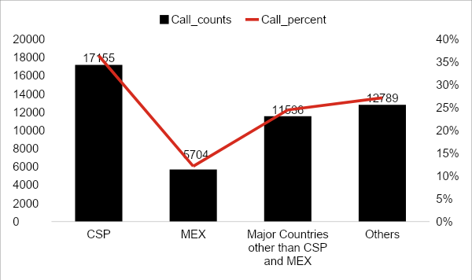
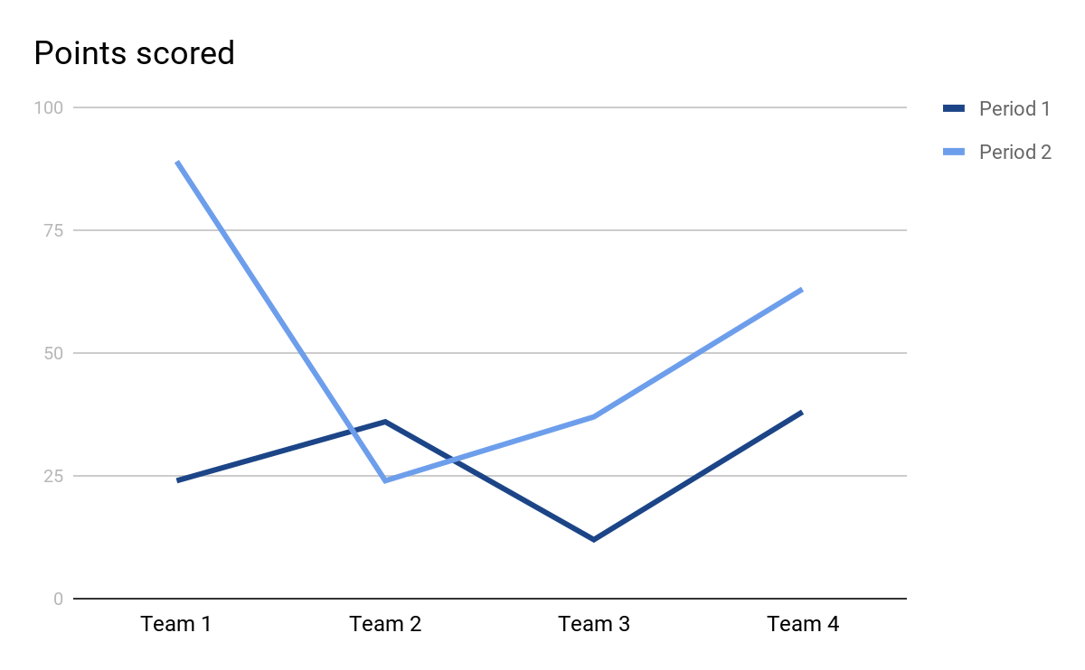
Country-Wise Cruise Distribution - Feb’19 to May’19
Country | Call_Counts | Call_Percent
CSP | 17K | 36%
MEXICO | 5.7K | 12%
CANADA | 2.8K | 6%
BAHAMAS | 2.7K | 6%
JAMAICA | 2.1K | 5%
DOMINICAN REPUBLIC | 1.3K | 3%
GREAT BRITAIN | 1K | 2%
ARUBA | 0.8K | 2%
ITALY | 0.75K | 2%
Others | 13K | 27%
Total | 47K | 100.00%
CSP - International waters
36% of the cruise related calls are from the ship

Slide 41
International Travel Intent
Using SOI, predictive analytics and machine learning to
personalize and predict the international travelers needs.
Current Scenario | ~10% of customers contact CS prior to International Travel, and of those only 5% attempt self-serve (online international page) prior to calling. 52% of the travellers added a international plan/feature. By proactively reaching these customers, the team has determined an opportunity of 500K call deflections, totaling $5M in operational savings
Models / Interventions | Call topic/Intent Prediction Model and deflection to self serve
Predicted Financial impact | Plan recommender
2019 | 2020 | 2021 | 2022 | 2023
$3.8M | $5M | $5M | $5M | $5M

Slide 42



Work in Progress
Real Time Streaming
Use cases
Alert System
Call Intent Prediction : Divert to Self Service
Multi label for increased accuracy
Scaling across Domains like Accessories, Billing etc.
Promotion & Service Recommendation
Difficult Customer
Customer
Skill
Agent
IVR
Regular Customer
Regular Agent
Verizon confidential and proprietary. Unauthorized disclosure, reproduction or other use prohibited.
Verizon confidential and proprietary. Unauthorized disclosure, reproduction or other use prohibited.

Slide 43
Appendix C

Slide 44
International travel page analysis- 19K calls could have been reduced using right communication
Total calls Before Travel
550K (100%)
Visited Online
Visited Mobile
99K (18%)
151k (28%)
International Page Visited = Yes
International Page Visited = No
Not Purchased Plan
International Page Visited = Yes
International Page Visited = No
128K (23%)
35K (35%)
64K (65%)
27K (18%)
123K (81%)
Purchased Plan Before call
Not Purchased Plan
Purchased Plan after call
Opportunity 2: 7.5K calls are sales calls – potential to reduce by sending the right message by creating a predictive model
19k (19%)
8k(8%)
7.5k (7.5%)
Opportunity 1: 19K calls have Potential to migrate to Self Serve
December’18,Feb’19-May’19
Notes:
Opportunity 1: 19K calls have Potential to migrate to Self Serve
Opportunity 2: 7.5K calls are sales calls – potential to reduce by sending the right message by creating a predictive model

Slide 45
$2.4M potential Opportunity to sell travel pass by predicting propensity to buy
Plan Purchased without Call
(56%,6M)
Travelled
(11M)
(0.6M * $5 per travel pass * 1/3rd up take) =
0.6M*5*1/3 = $1M for 5 months ~ $2.4M per annum
Opportunity to sell travel pass to customers using predictive model for incremental revenue of $2.4M
Visited Online
(14%,0.6M)
International Page Visited
(24%, 0.1M)
Plan Purchased before call
(5%, 0.5M)
Plan Purchased after call
(1.15%, 0.1M)
Called and not purchased 2%,183k
Plan not Purchased
(38%,4M)
December’18,Feb’19-May’19
Notes:
Visits to website
Plan not Purchased
(38%,4M)
Opportunity to sell travel pass to customers using predictive model

Slide 46
International Call Intent Categories
Call Before Travel
Call During/ After Travel
Plan/Tp Enquiry
(169,361, 37.20%)
Bill Details
(55,031, 36.10%)
Bill Details
(52,727, 11.60%)
Plan/Tp Enquiry
(30,290, 19.90%)
Plan/Tp Data & Wifi
(47,718, 10.50%)
Plan /Tp Data & Wifi
(12,907, 8.50%)
Coverage
(35,644, 7.80%)
Phone Settings
(10,292, 6.80%)
Family
(34,049, 7.50%)
Family
(9,938, 6.50%)
Observations
On average 73 % travellers calling before travel High volume of Cruise Plan enquiries during Nov and Dec Billing related coll volume significantly high after travel
Cruise Plan
(32,792, 7.20%)
Coverage
(7,985, 5.20%)
Verizon confidential and proprietary. Unauthorized disclosure, reproduction or other use prohibited.

Slide 47
APPENDIX D Call Listening's observation

Slide 48
Customer Pain Points
Significant no. of people going on cruises to Caribbean/ Bahamas/CA, travel pass does not work on cruises, separate plans, some agents not aware
Troubleshooting related to settings
Recent Plan change/ upgrade/ new
Age/Type of device - Old
Account manager/owner and caller different
Repeat calls due to call drop or network refresh, etc. Agent callback goes to voicemail
Plan confirmation before day of travel
Bill credits
Billing confusion: Different bill cycle end date, payment due date & autopay date
Recall since customers get confused when agents say travel pass for a "day" rather than for a “24 hr session following first usage” - they think 0:00 to 23:59
Notes:
Customer intelligence is everywhere. There is a lot of work happening in the individual domain areas but there is no easy way to expose those insights. We have a need to complement those efforts by providing a consistent way to operationalize that intelligence.
AI is the new UI. We need to empower the systems of engagement to personalize the experience based on intelligence instead of just profile attributes. For this, the data needs to be curated into actionable insights of present, past and future and made available for easy consumption.
DataOps: DevOps for AI. Centralized system for operationalizing AI. Deploy and execute predictive models at scale in real-time and in batch modes
Comprehensive, consistent NBX capability covering preemptive, proactive, reactive for various business objectives

Slide 49
APPENDIX E Online Visit Statistics
May 5, 2019

Slide 50
Customer journey map on Online Visit
Total Travelers
(2.1M)
(29%,95k)
(92.6%,88k)
(62.5%,55k)
Total Online Visitors
(15%, 326K )
Error in session
Error and Not Called
Plan purchased
Traveled
Error and called
(18%,935k)
(5.4%,5.2k)
Plan purchased After call
From the analysis it appears that 5.4% of the travelers who encountered error in session called customer service and 18% of them purchased plan after they called.
Probable areas leading to session errors can be evaluated.
Evaluating the chat bot commands to make it simpler to the customers can result in reduction of call volume.
Building propensity models to identify customers who are having a higher propensity to travel can be detected earlier and target them for upselling of products results in increased revenue.
Plan purchased Before call
(57.7%,3k)
Notes:
Identify International page visitors who will call customer care
No error – calls , 3700
30K – 20.5K has plan, 10K no plan
PPBC – 1213, PPAC – 400, NP – 495
1385 –
528 -

Slide 51
